Slide 1
AWS Well architected framework

Slide 2


Design for failure
Always design for automated recovery
Assume hardware will fail, outages will occur.
Think about recovery strategies at design time

Slide 3

Decouple components
Avoid tight dependencies between components
For e.g. If using EC2 infra, use ALBs to distribute request load to multiple EC2 in target group. Keep a stable endpoint using Route53.
Asynchronous integration: Use queues for integration between components. For e.g. Front end app inserts requests in SQS queue. The backend server consumes the requests and processes them. In an event of backend server failure, the requests will be retained in SQS, and processes automatically once backend system recovers.

Slide 4
Implement Elasticity
Proactive cyclic scaling (expected recurring surge in requests)
Proactive event based scaling ( product launch, marketing campaigns)
Autoscaling based on demand (scaling based on metrics for e.g. CPU utilization)

Slide 5
Secure your Application
Deny all traffic to DB (for e.g. put in private subnet. Associate SG with no access except app layer)
Only allow SSH access (22) to app server. Associate SG with access only over VPN or to Bastion host (jump box)

Slide 6
Well Architect Framework
5 Pillars
Security
Reliability
Performance Efficiency
Cost Optimization
Operational Excellence

Slide 7
General design principles
Stop guessing capacity needs
Test production scale in dev environment
Employ infrastructure as code
Data driven architecture (for e.g. use data from cloud watch to evolve architecture)
Hold Game Days

Slide 8
First Pillar: Security
Apply security at all layers:
NACL (subnet), SG (instance)
Enable traceability (Cloud trail)
Antivirus agents on instances (hardened Golden AMI)
Automate response to security events (detect brut force and take action)

Slide 9
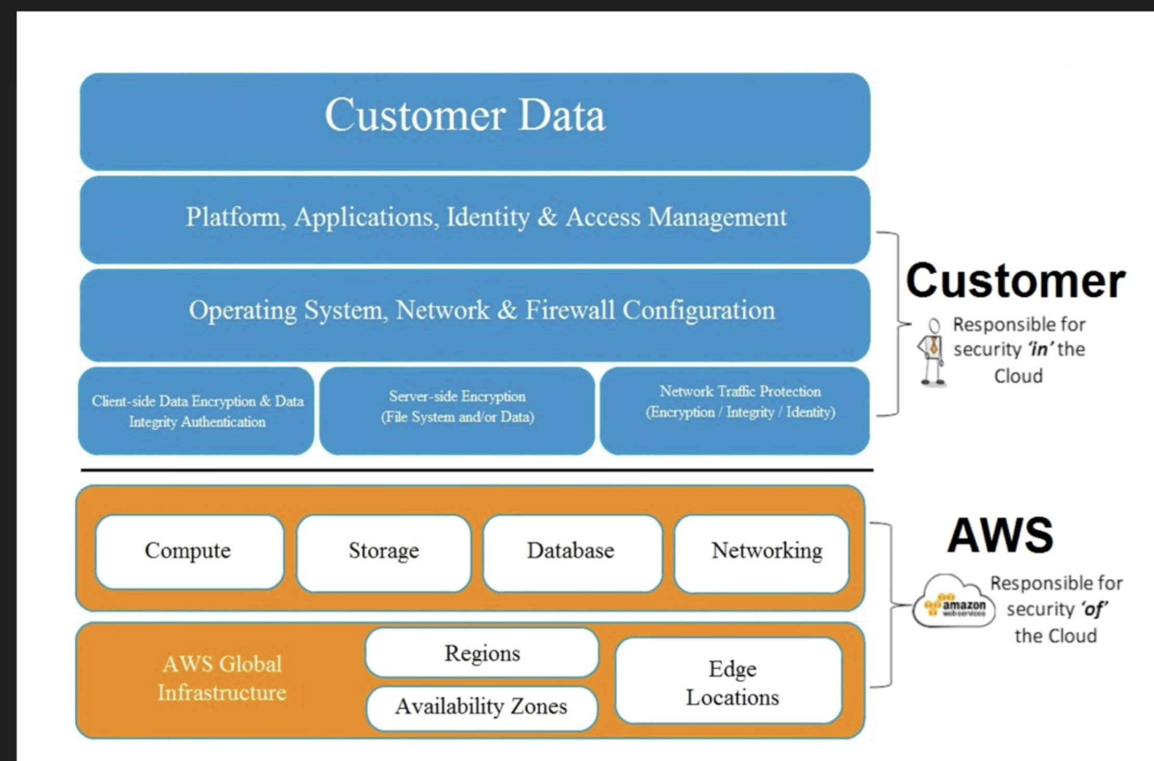

Slide 10
Data Protection
Distinguish Publicly availability Data vs other data
Least privilege access system. People can only access what they need. (IAM)
Encrypt everything (REST and/or in transit)
Versioning

Slide 11
Privilege Management
ACLs
Role based access (IAM)
Password rotation
Enabled MFA?
Are you using Groups?

Slide 12
Infrastructure protection
AWS protects it for you for e.g. you don’t need to hire security guards

Slide 13
Detective controls
AWS Cloudtrail: creates event history of users, groups or AWS services taking actions. For e.g. a lambda that deletes old unattached EBS volumes (if enabled)
AWS cloudwatch (for e.g. if you see a sudden high CPU spike, maybe someone breaches VPC’s EC2 for bitcoin mining)

Slide 14
Reliability - general
Ability to dynamically recover from disruption
Test recovery procedures
Stop guessing capacity

Slide 15
Reliability - Foundations
Are service limits being managed?(AWS technical account manager)
Escalation path established?

Slide 16
Reliability – Change management
Cloud watch alarms (recovery)
Cloudtrail for monitoring events
AWS Config
RDS events

Slide 17
Reliability - Failure management
Architect assuming hardware failure
How is data being backed up? (RDS daily backups, EBS/EFS mounts)
Component failure management and recovery (ASG)

Slide 18
Performance Efficiently Pillar
Using compute resources efficiently
Selecting the correct instance type

Slide 19
Performance - storage
Access method – block, file, object
Durability constraints
Frequency of access (glacier or S3)

Slide 20
Performance DBs
SQL DBs - RDS
No SQL DBs DynamoDB
Datawarehousing - Redshift

Slide 21
Space time tradeoff
Add read replicas to RDS to lower latency due to load
1
Direct connect to provide predictable latency from DC to AWS
2
Use Cloudfront for caching based on region
3

Slide 22
Cost Optimization Pillar
Match supply and Demand
ASG
Serverless – only charged when requests come in
Expenditure Awareness
Decommissioning plan
Cost monitoring
AWS trusted advisor

Slide 23
Operational Excellence Pillar
Perform operations with code
Align operations processes to business objective
Make small incremental changes
Keep operations procedures up to date

Slide 24
Operational Excellence - Preparation
Runbooks – daily tasks
Playbooks – unexpected operational event, response plan, escalation plan

Slide 25
Operational Excellence - Operations
Use CICD – allows to track small incremental changes

Slide 26
Operational Excellence - Response
CW Alarm triggers => SNS

Slide 27
White paper notes
Design Principles
Scalability: 2 ways to scale
Vertical: up the specifications on resource (Can suffice short term)
Horizontal: Add more nodes (leverages elastic cloud computing more)
Stateless apps
Workload Distribution
Push – ELB
Pull – SQS
Implement Sticky sessions (ALB)
Implement distributed processing (EMR to run Hadoop workloads)

Slide 28
White paper notes
Ephemeral infrastructure
Instantiate new instances using bootstrapping (init scripts in user data)
Golden or Silver AMI
Containerization (ECS – Fargate, build golden docker images managed on ECS registry
Infrastructure as Code (cfn, ansible, terraform)

Slide 29
White paper notes
Automation
EC2 auto-recovery (cloudwatch alarms)
Autoscaling (horizontal scaling)
Alarms and events (cloudwatch)
Loose coupling
Well defined technology agnostic interfaces (Restful APIs)
Use API GW or equivalent to manage/publish APIs
Service discovery (implemented via ELB endpoint)
Asyncronous integration (using SQS to avoid loss of requests)
Route53 failover to backup site
Services, not server (for e.g. ELB, S3, SQS,

